Slide 1


<Name>
<Date>

Slide 2

Outline
Executive Summary
Introduction
Methodology
Results
Conclusion
Appendix

Slide 3
Executive Summary
Goal: Predicting if the SpaceX Falcon 9 first stage will launch successfully using machine learning algorithms for classification.
Main Processes:
• Data collection, wrangling, and formatting
• Exploratory data analysis
• Interactive data visualization
• Machine learning prediction
Notes:
• Our graphs show that some features of rocket launches have a correlationwith the outcome of the launches, i.e., success or failure.• It is also concluded that decision tree may be the best machine learningalgorithm to predict if the Falcon 9 first stage will land successfully

Slide 4
Introduction
Background :
Space X has the best pricing ($62 million vs. USD 165 million)
Largely due to the ability to recover part of the rocket (Stage 1)
Space Y wants to compete with Space X
Problem:
Space Y tasks us to train a machine learning model to predict successful Stage 1 recovery

Slide 5

Section 1

Slide 6
Methodology
Executive Summary
Data collection methodology:
Using SpaceX API, Web scraping
Perform data wrangling
Exploratory data analysis (EDA), using: Pandas and NumPy
Perform exploratory data analysis (EDA) using visualization and SQL
Perform interactive visual analytics using Folium and Plotly Dash
Perform predictive analysis using classification models
Machine learning prediction, using • Logistic regression • Support vector machine (SVM) • Decision tree • K-nearest neighbors (KNN)

Slide 7
Data Collection
Data sets were collected via API requests from Space X public API and web scraping related data from tables of Space X
key phrases: FlightNumber, Date, BoosterVersion, PayloadMass, Orbit, LaunchSite, Outcome, Flights, GridFins, Reused, Legs, LandingPad, Block, ReusedCount, Serial, Longitude, Latitude
Please see next slide for flowcharts

Slide 8
Data Collection – SpaceX API
data collection with SpaceX REST calls from API via Requests.get() function
GitHub URL of the completed SpaceX API calls notebook: https://github.com/MicoLi-Git/IBM-DS-Capstone-Project/blob/main/1_jupyter-labs-spacex-data-collection-api.ipynb
Request Space X data from API
Get required data from HTML data
Clean the Json format data to python DataFrame
Filtering the needed data

Slide 9
Data Collection - Scraping
web scraping process
GitHub URL of the completed web scraping notebook: https://github.com/MicoLi-Git/IBM-DS-Capstone-Project/blob/main/2_jupyter-labs-webscraping.ipynb
Request Space X data from Wikipage
Get required data from HTML data
Extract the columns and variables
Created a dataframe to store above data

Slide 10
Data Wrangling
Identify and calculate the percentage of the missing values in each attribute
Calculate the number of launches on each site
Calculate the number and occurrence of each orbit
Calculate the number and occurence of mission outcome of the orbits
Create a landing outcome label from Outcome column
New training label column ‘class’ with a value of 1 if ‘Mission Outcome’ is True and 0 otherwise. Value Mapping:
True ASDS, True RTLS, & True Ocean – set to -> 1
None None, False ASDS, None ASDS, False Ocean, False RTLS – set to -> 0

Slide 11
EDA with Data Visualization
Exploratory Data Analysis performed on variables Flight Number, Payload Mass, Launch Site, Orbit, Class and Year.
Plots Generated:
Flight Number vs. Payload Mass
Flight Number vs. Launch Site
Payload Mass vs. Launch Site
Orbit vs. Success Rate
Flight Number vs. Orbit
Payload vs Orbit
Yearly Success Launch Trend

Slide 12
EDA with SQL
Loaded data set from IBM DB2 Database
Queried using SQL integration from Python
Explored the data by querying information about launch site names, mission outcomes, various, and pay load sizes of customers and booster versions, and landing outcomes

Slide 13
Build an Interactive Map with Folium
Folium maps mark Launch Sites, successful and unsuccessful landings, and a proximity example to key locations: Railway, Highway, Coast, and City.
This allows us to understand why launch sites may be located where they are. Also visualizes successful landings relative to location.

Slide 14
Build a Dashboard with Plotly Dash
Dashboard includes a pie chart and a scatter plot
Pie chart for visualizing launch site success rate
showing distribution of successful landings across all launch sites and can be selected to show individual launch site success rates.
Scatter plot generated that how success varies across launch sites, payload mass, and booster version category.
inputs: All sites or individual site and payload mass on a slider

Slide 15
Predictive Analysis (Classification)

Slide 16
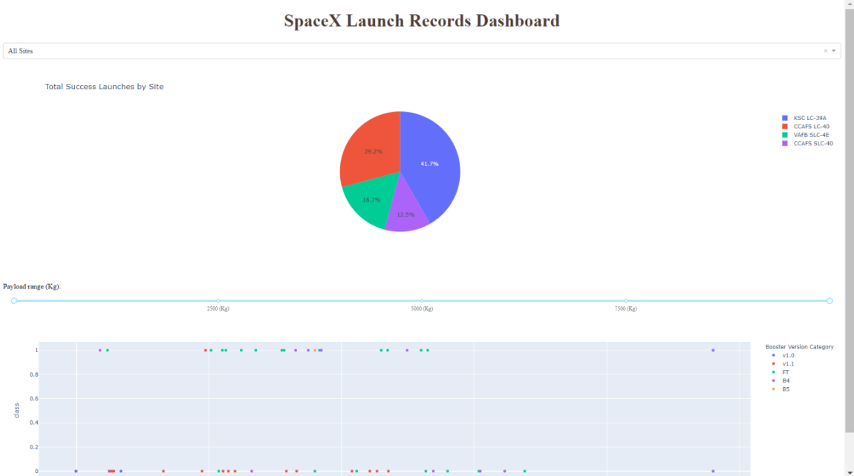
Results

Slide 17

Section 2

Slide 18
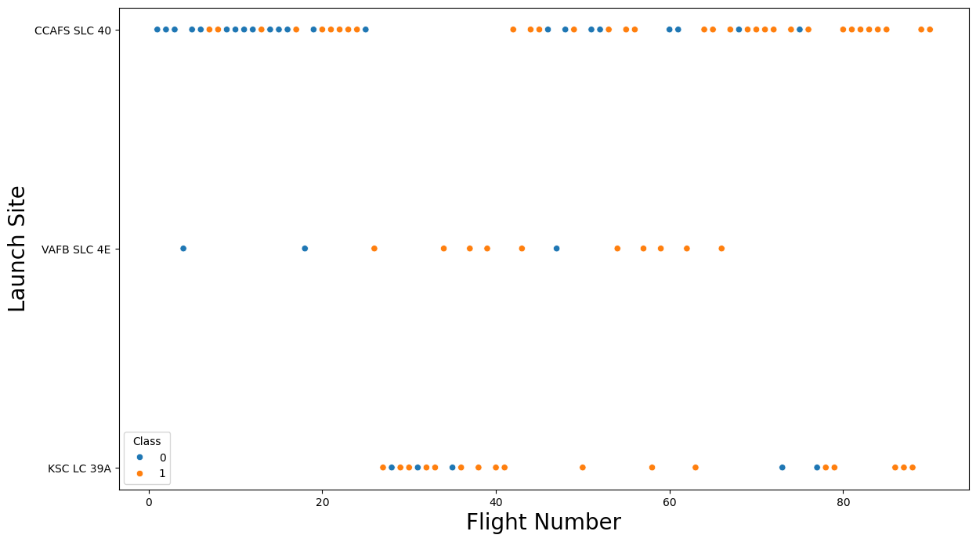
Flight Number vs. Launch Site
Show a scatter plot of Flight Number vs. Launch Site
Show the screenshot of the scatter plot with explanations

Slide 19
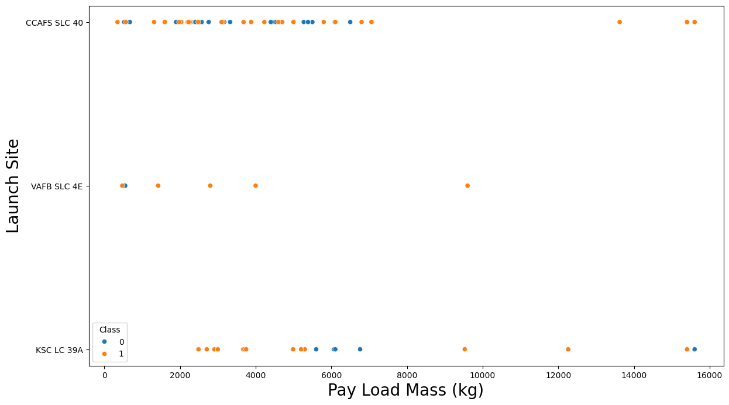
Payload vs. Launch Site

Slide 20
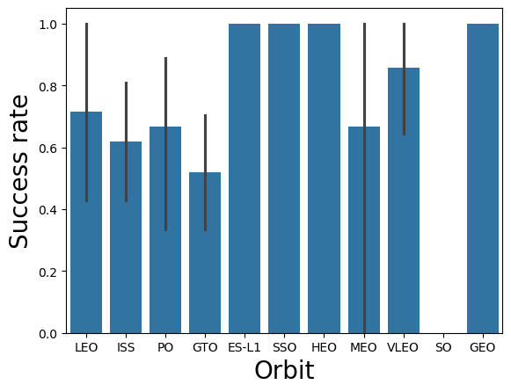
Success Rate vs. Orbit Type

Slide 21
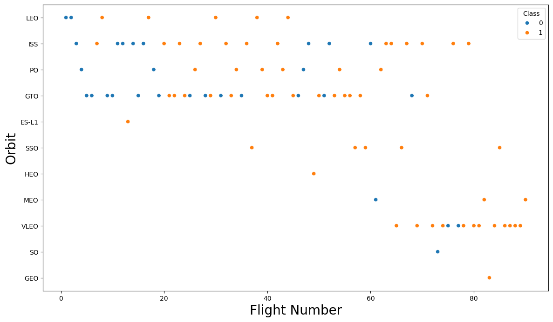
Flight Number vs. Orbit Type

Slide 22
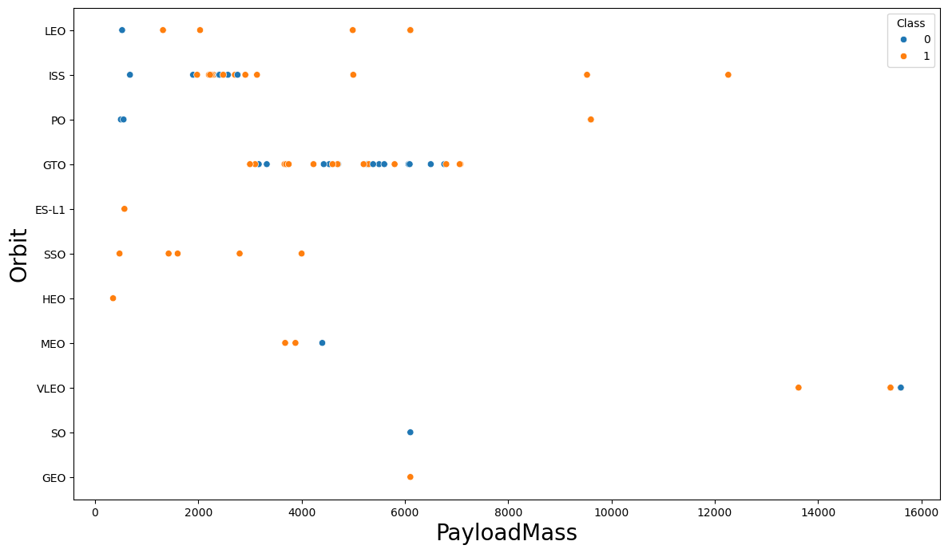
Payload vs. Orbit Type

Slide 23
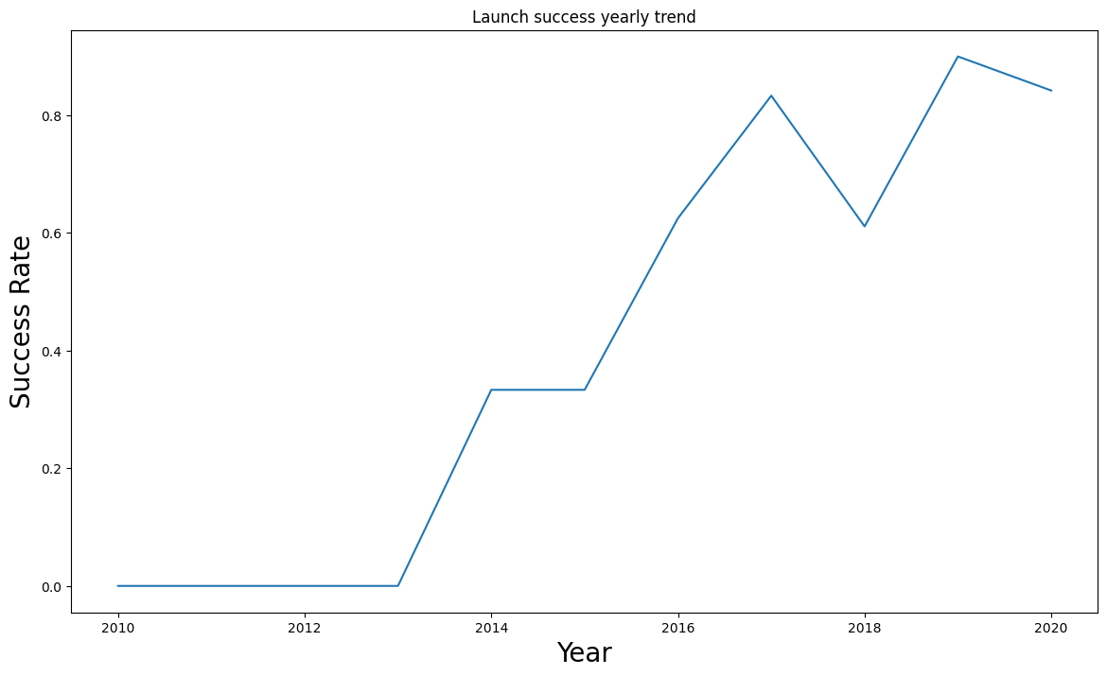
Launch Success Yearly Trend

Slide 24
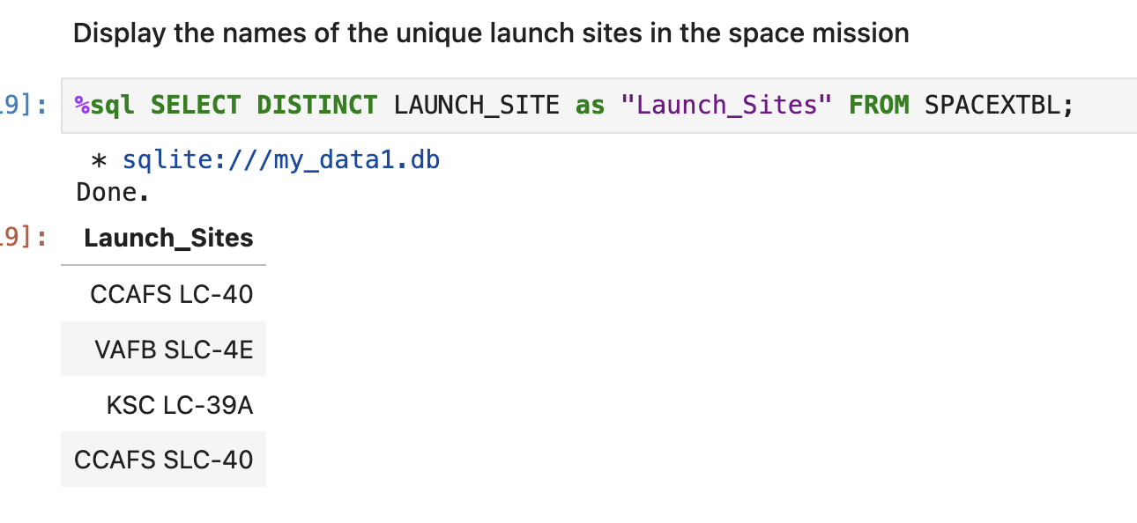
All Launch Site Names

Slide 25
Launch Site Names Begin with 'CCA'
Date | Time (UTC) | Booster_Version | Launch_Site | Payload | PAYLOAD_MASS__KG_ | Orbit | Customer | Mission_Outcome | Landing_Outcome
2010-06-04 | 18:45:00 | F9 v1.0 B0003 | CCAFS LC-40 | Dragon Spacecraft Qualification Unit | 0 | LEO | SpaceX | Success | Failure (parachute)
2010-12-08 | 15:43:00 | F9 v1.0 B0004 | CCAFS LC-40 | Dragon demo flight C1, two CubeSats, barrel of Brouere cheese | 0 | LEO (ISS) | NASA (COTS) NRO | Success | Failure (parachute)
2012-05-22 | 7:44:00 | F9 v1.0 B0005 | CCAFS LC-40 | Dragon demo flight C2 | 525 | LEO (ISS) | NASA (COTS) | Success | No attempt
2012-10-08 | 0:35:00 | F9 v1.0 B0006 | CCAFS LC-40 | SpaceX CRS-1 | 500 | LEO (ISS) | NASA (CRS) | Success | No attempt
2013-03-01 | 15:10:00 | F9 v1.0 B0007 | CCAFS LC-40 | SpaceX CRS-2 | 677 | LEO (ISS) | NASA (CRS) | Success | No attempt

Slide 26
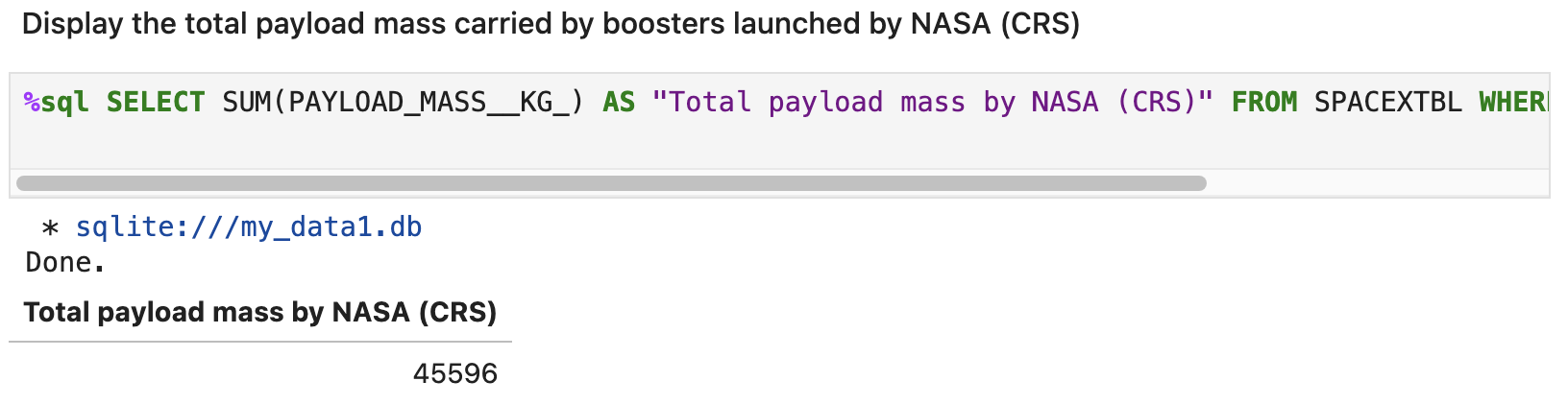
Total Payload Mass

Slide 27
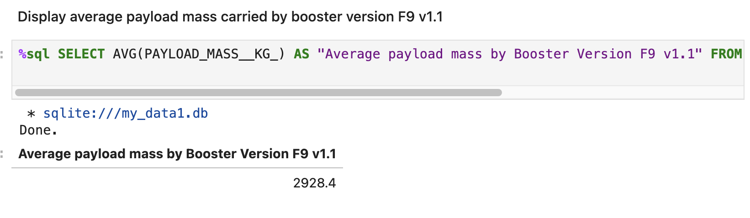
Average Payload Mass by F9 v1.1

Slide 28
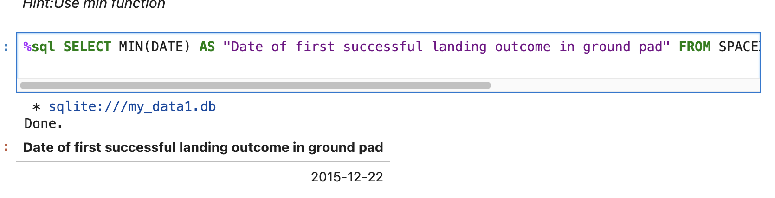
First Successful Ground Landing Date

Slide 29
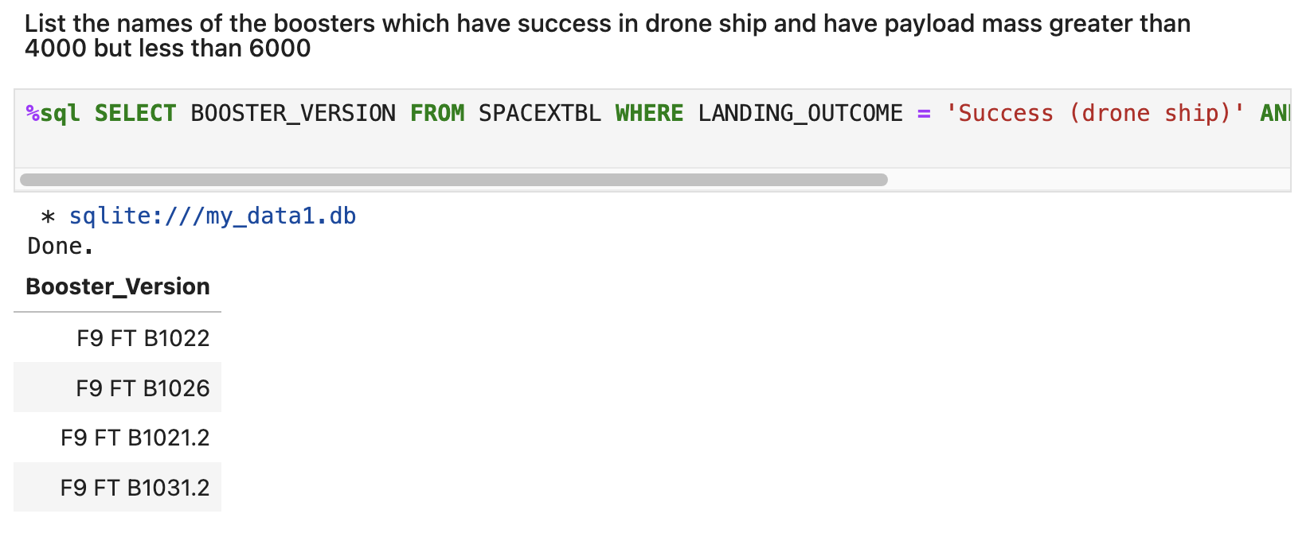
Successful Drone Ship Landing with Payload between 4000 and 6000

Slide 30
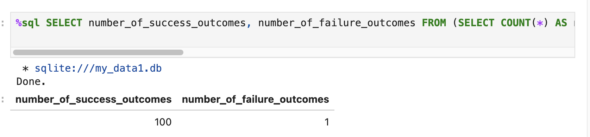
Total Number of Successful and Failure Mission Outcomes

Slide 31
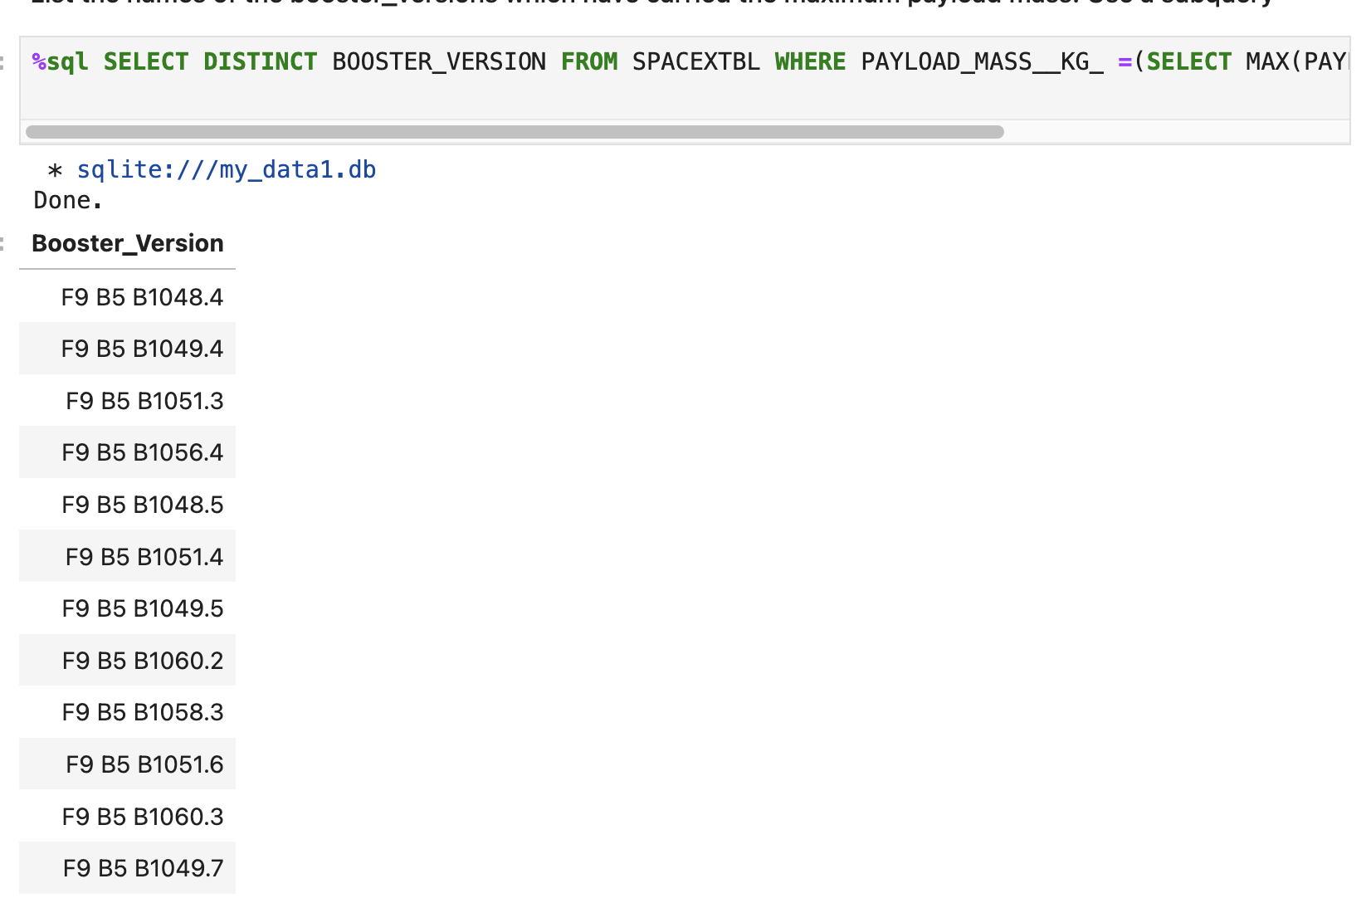
Boosters Carried Maximum Payload

Slide 32
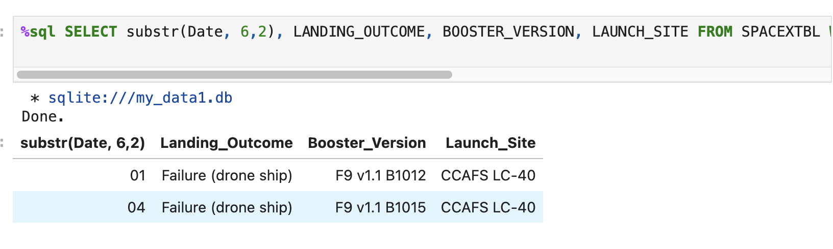
2015 Launch Records

Slide 33
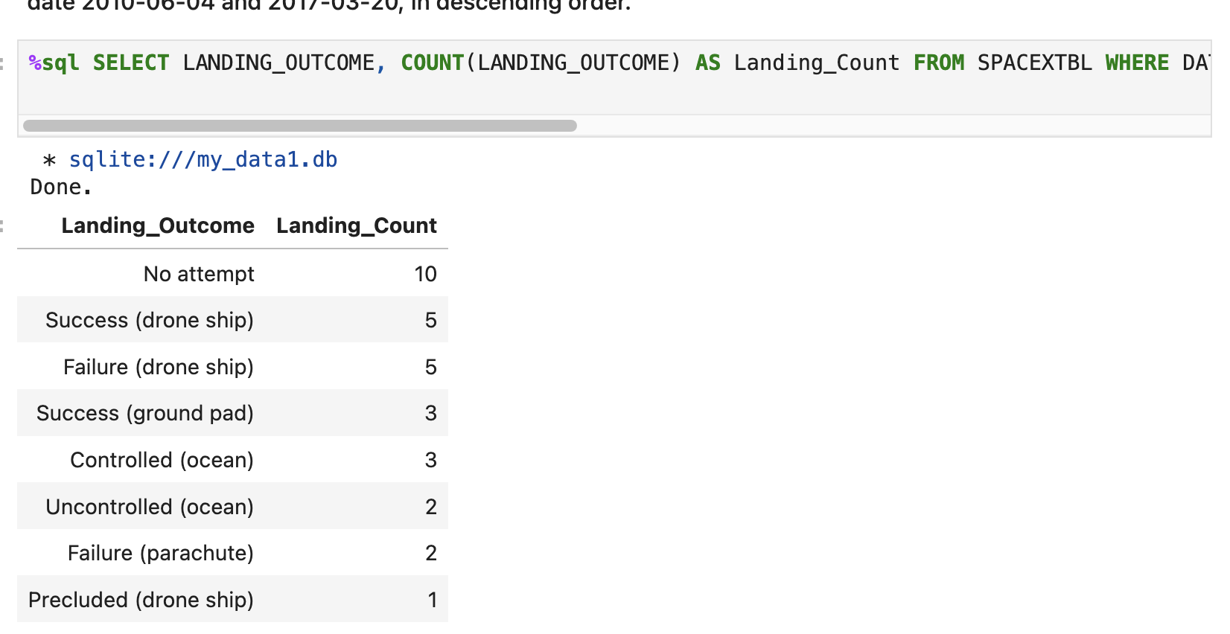
Rank Landing Outcomes Between 2010-06-04 and 2017-03-20

Slide 34

Section 3

Slide 35
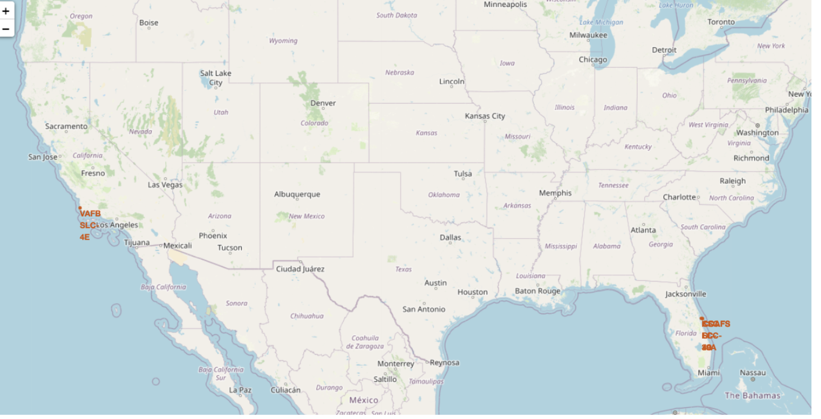
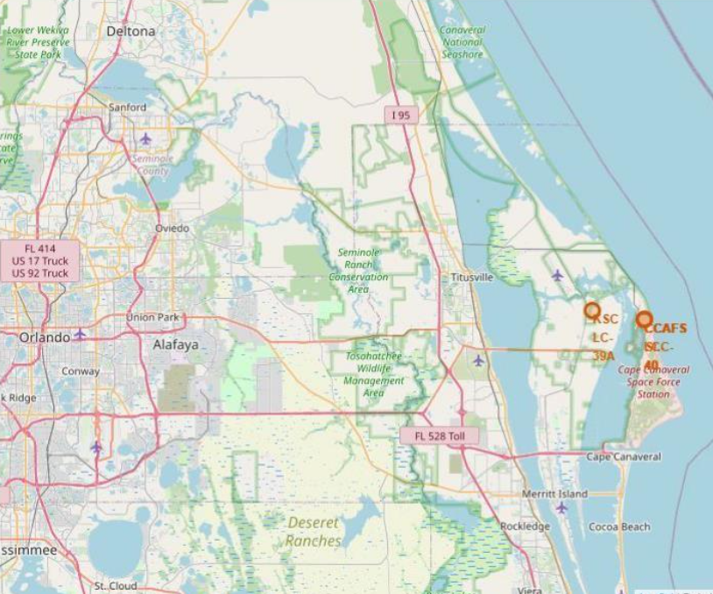
<Folium Map Screenshot 1>

Slide 36
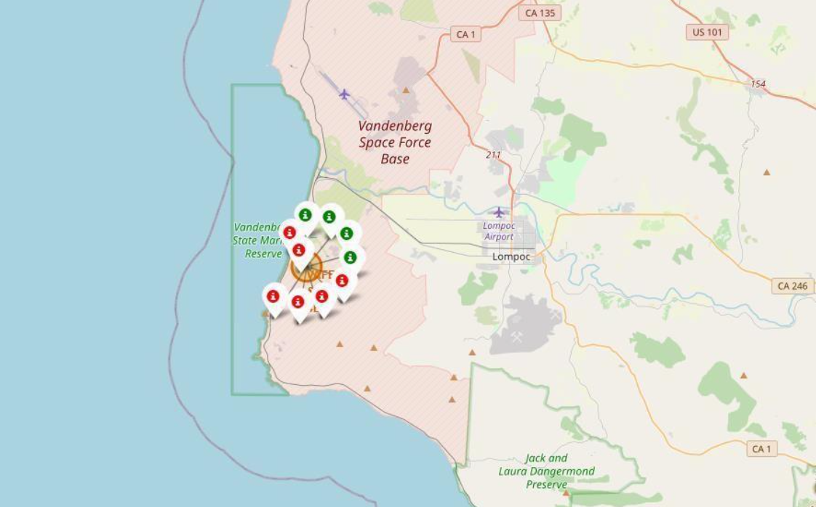
<Folium Map Screenshot 2>

Slide 37
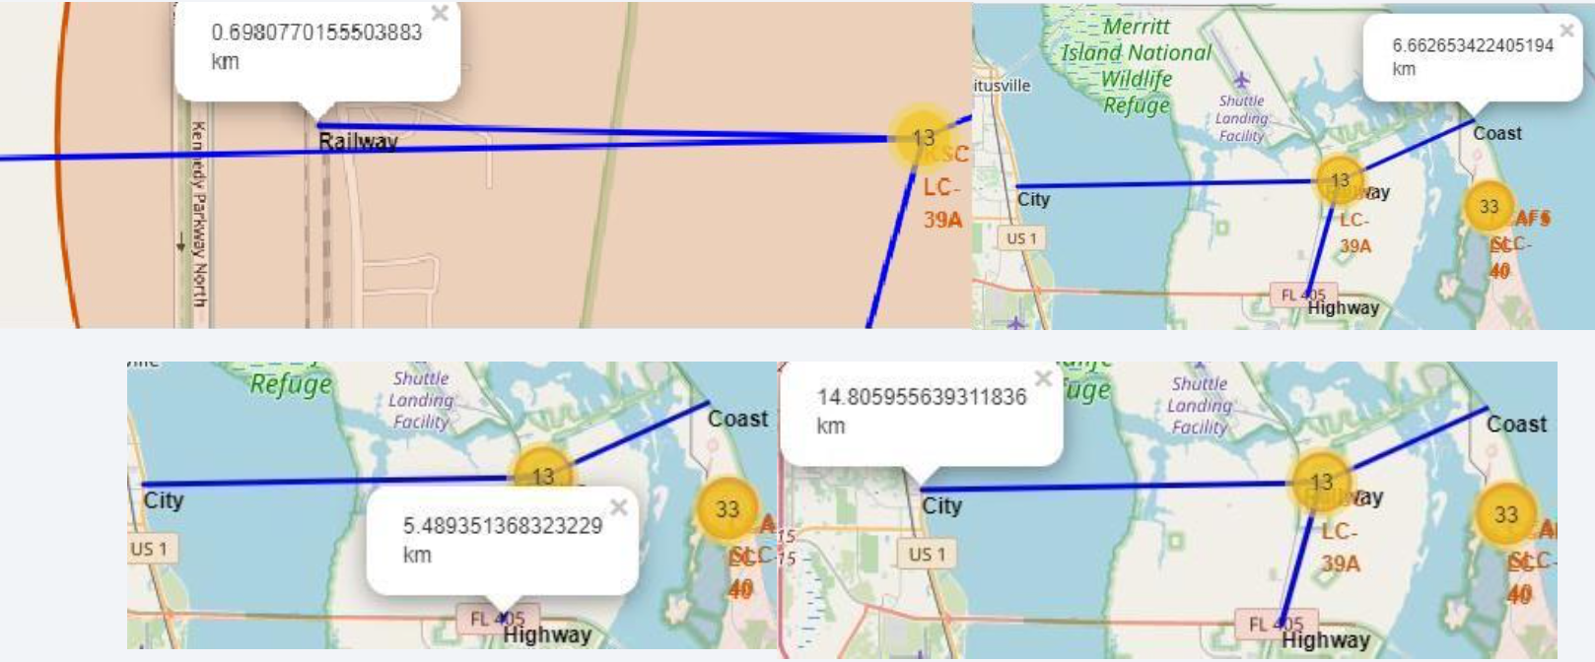
<Folium Map Screenshot 3>

Slide 38

Section 4

Slide 39
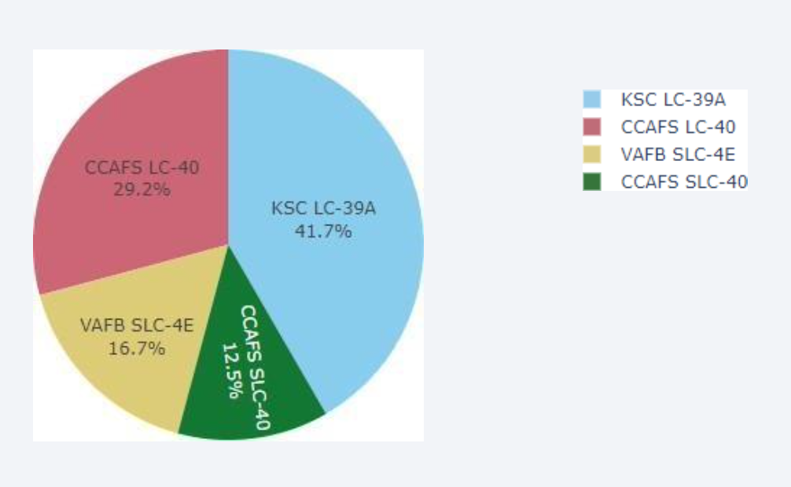
<Dashboard Screenshot 1>

Slide 40
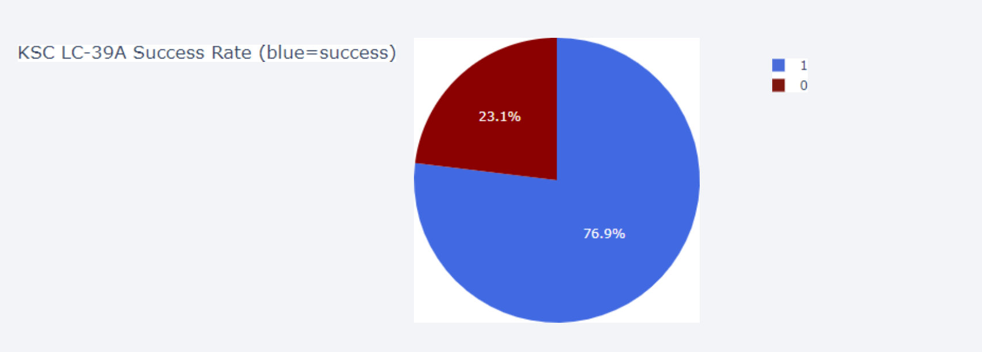
<Dashboard Screenshot 2>

Slide 41

<Dashboard Screenshot 3>

Slide 42

Section 5

Slide 43
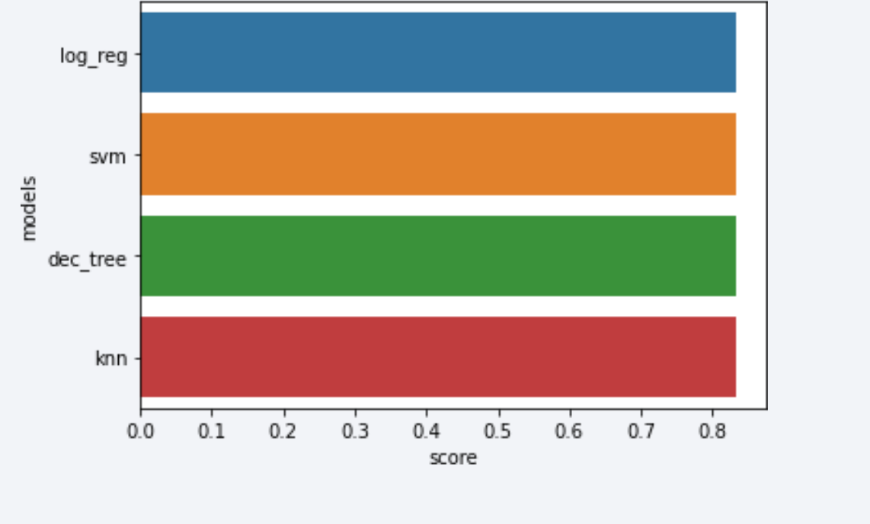
Classification Accuracy

Slide 44
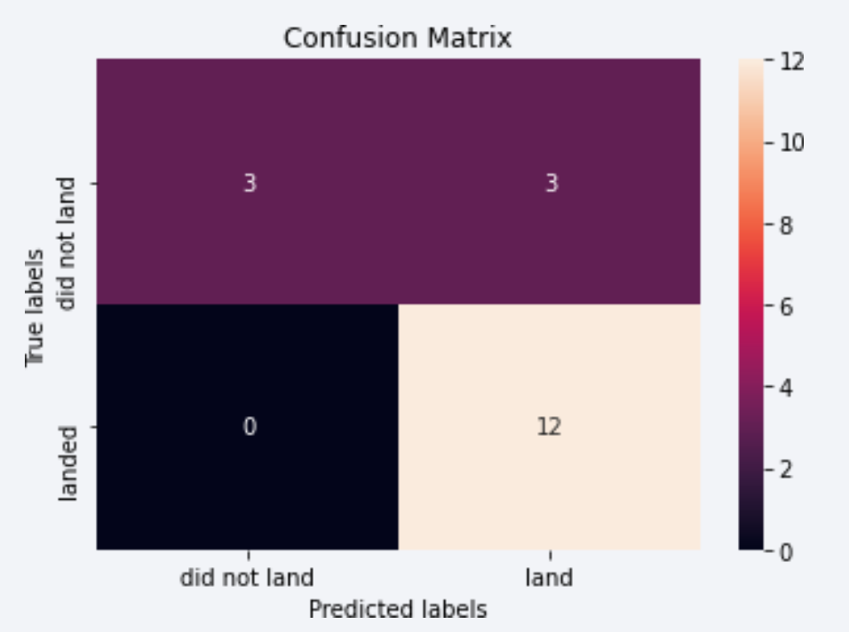
Confusion Matrix

Slide 45
Conclusions
Objective: Predict the success of the Falcon 9 first stage landing to estimate the overall launch cost.
Approach: Analyzed key features of Falcon 9 launches, such as payload mass and orbit type, to evaluate their impact on mission outcomes.
Methods: Implemented and compared multiple machine learning algorithms to identify patterns in historical Falcon 9 launch data and develop predictive models.
Results: Among the four machine learning algorithms employed, the decision tree model demonstrated the best predictive performance.

Slide 46


